Slide 1

Conceptual Modeling Example
Company-Consultant

Slide 2
P
Problem Description
A company is identified by a company ID and described by its company name and the type of industry in which it exists. A company hires consultants, identified by a consultant id and described by the consultant’s name and specialty. Assume that a consultant can work for only one company at a time. We need to create a database to keep track of consulting engagements, including the date for which a consultant was hired. The hourly rate the consultant charges may differ, depending upon the company.
What might be “tricky” about modeling this problem?

Slide 3
P
Conceptual Model: Chen Notation
name
date
hired
hourly
rate
name
ID
industry
ID
specialty
Company
M
hires
N
Consultant

Slide 4
P
Conceptual Model: Chen Notation
name
date
hired
hourly
rate
name
ID
industry
ID
specialty
Company
(0,M)
hires
(1,N)
Consultant

Slide 5
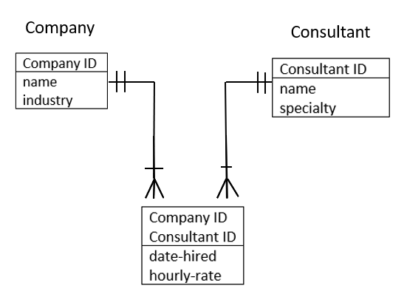
A company is identified by a company ID and described by its company name and the type of industry in which it exists. A company hires consultants, identified by a consultant id and described by the consultant’s name and specialty. Assume that a consultant can work for only one company at a time. We need to create a database to keep track of consulting engagements, including the date for which a consultant was hired. The hourly rate the consultant charges may differ, depending upon the company.

